Slide 1

TITLE
Implementation and Comparison of Various Shortest Path Algorithms and its Application

Slide 2
Introduction
A graph can be used to represent a map where the cities are represented by vertices and the routes are represented by edges within the graph.
The adjacency matrix for the undirected graph is always symmetric.
Removing an edge takes O(1) time. Questions like whether there is an edge from vertex ‘u’ to vertex ‘v’ are efficient and can be done O(1).
We also use linked lists for the representation of the graph. The weights of edges can be stored in nodes of linked lists.

Slide 3
Problem Statement
The shortest-route problem defines a route of minimum weight joining two specified vertices, source, and destination. (With weight graph in a transportation network).
Pathfinders helps you to plan a solution before time.
To set perfect harmony to determine the shortest path between any known or specified points and locations.
A sterling algorithm we used is Dijkstra’s algorithm.
This project aims at Implementing and Comparing Various Shortest Path Algorithms and their Application

Slide 4
Motivation
The Dijkstra algorithm is chosen because:
It is simple to execute and understand.
A variety of applications use this algo in various sectors.
To support dijkstra algorithm (the shortest path between a single vertex and all other vertices) we are using Floyd’s algorithm (finds the shortest path between all vertices).
More efficiency in the result.

Slide 5
OBJECTIVE
The aim is to find the shortest path from a given source location to a destination location in a city graph network. The program takes as an input text file that includes the location names and the distance between them and the source and destination locations. By Dijkstra’s algorithm and other algorithms, the program determines the shortest path between the 2 Points in the network and displays the shortest distance and the route to be taken to complete the same.

Slide 6
Methodology
This project presented a quantitative way to find the shortest path between the 2 locations in the city in the network using the Dijkstra algorithm. The overall proposed solution is described as follows:
Initialization of all nodes with distance "infinite"; initialization of the starting node with 0.
Marking of the distance of the starting node as permanent, all other distances as temporarily.
Setting of starting node as active.

Slide 7
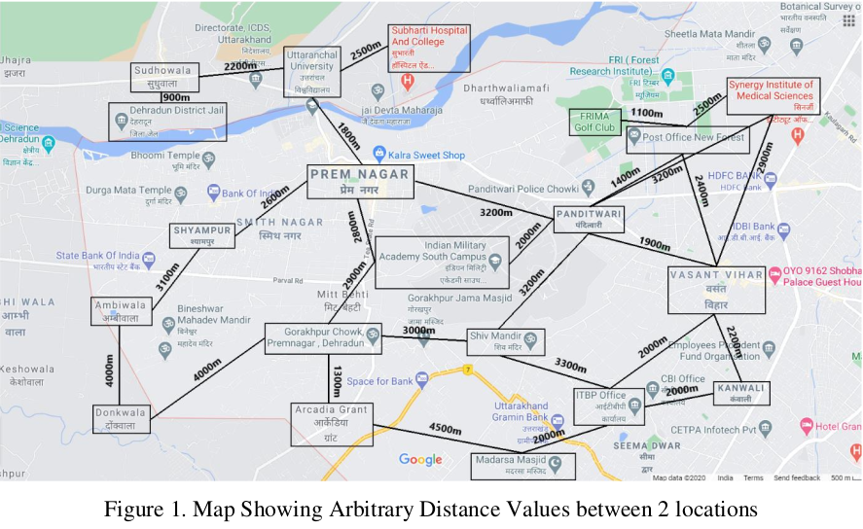
Calculation of the distances of all neighbour nodes of the active node by summing up its distance with the weights of the edges.
If calculated distance of a node is smaller as the current one, update the distance and set the current node as antecessor, this is called update and is Dijkstra's central idea.
Set node with the minimal temporary distance as active. Mark its distance as permanent.
Repeating above steps until there aren't any nodes left with a permanent distance, which neighbours still have temporary distances.

Slide 8
Work Done
Advantages of Dijkstra Algorithm -
It is used in Google Maps
It is used in finding Shortest Path.
It is used in geographical Maps
To find locations of Map which refers to vertices of graph.
Distance between the location refers to edges.
It is used in IP routing to find Open shortest Path First.
It is used in the telephone network.

Slide 9
Work Done
Disadvantages of Dijkstra Algorithm -
It do blind search so wastes lot of time while processing.
It cannot handle negative edges.
This leads to acyclic graphs and most often cannot obtain the right shortest path.

Slide 10
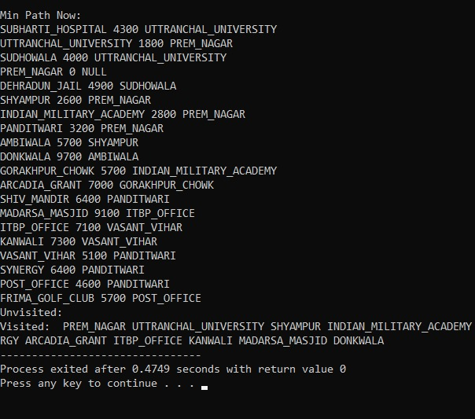

Slide 11
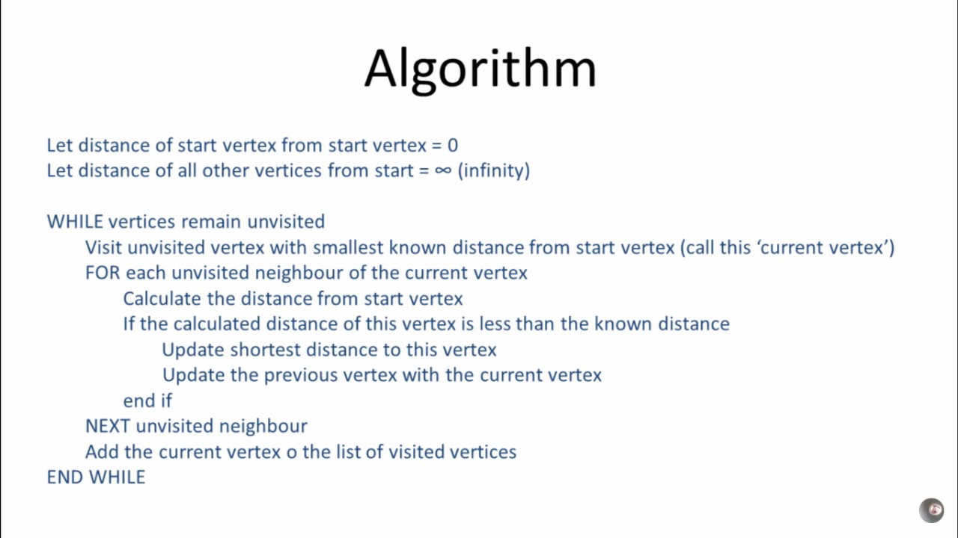
Coded Algorithm

Slide 12
WORK LEFT FOR FUTURE
Implementation of Other shortest path algorithm like Floyd Warshall.
Comparison between Dijkstra’s Algorithm with Floyd Warshall.
Comparison between their Time Complexity.
Comparison between their Efficiency and Space Complexity.

